Slide 1
Sulforaphane has Opposite Effect in Some Orthologous Genes
Whitney Finney

Slide 2
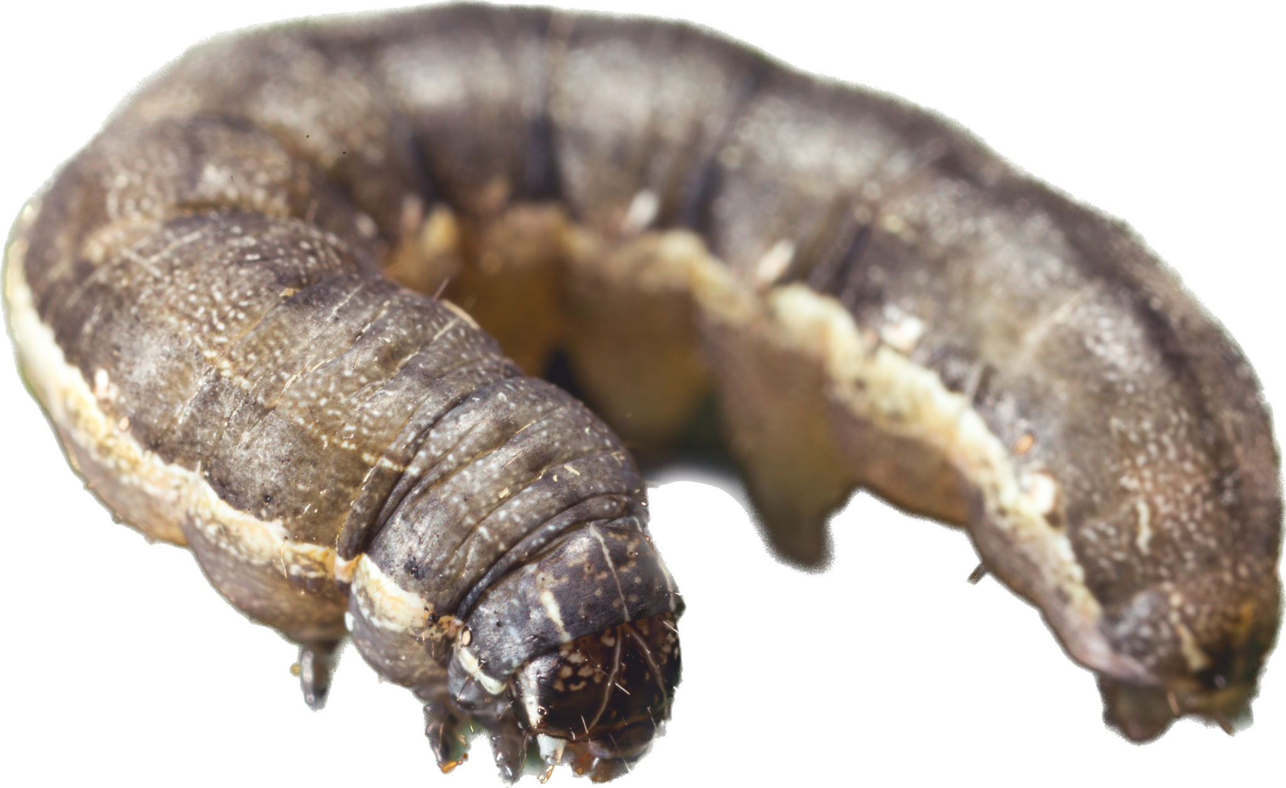
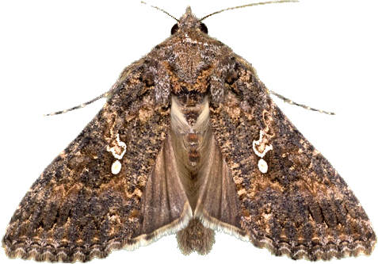
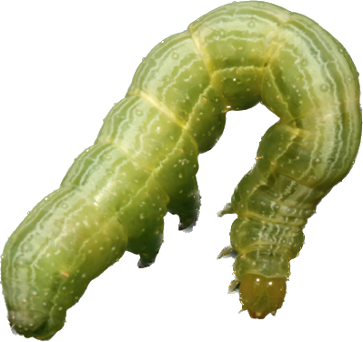
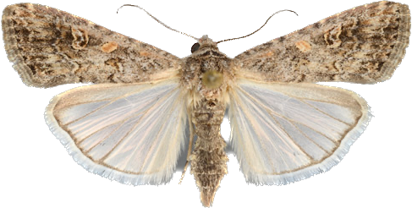
Background
Spodoptera exigua (S. exigua)
Trichoplusia ni (T. ni)
Beet Armyworm
Generalist feeder
Cabbage Looper
Specialist feeder
Sulforaphane (SFN) is found naturally in cruciferous vegetables
HDAC inhibitor
Disrupts DNA structure
Epigenetically changes DNA expression

Slide 3
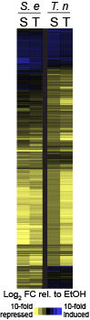
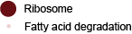
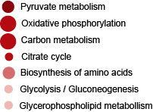
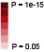
Review: SFN changes gene expression in fat body tissues
307 induced genes enriched for
Genes associated with ribosome production and fatty acid degradation are upregulated.
Genes associated with energy production are downregulated.
SFN and TSA generate similar patterns in gene expression.
1615 repressed genes enriched for

Slide 4
What are the orthologous genes that SFN has an opposite effect on?

Slide 5
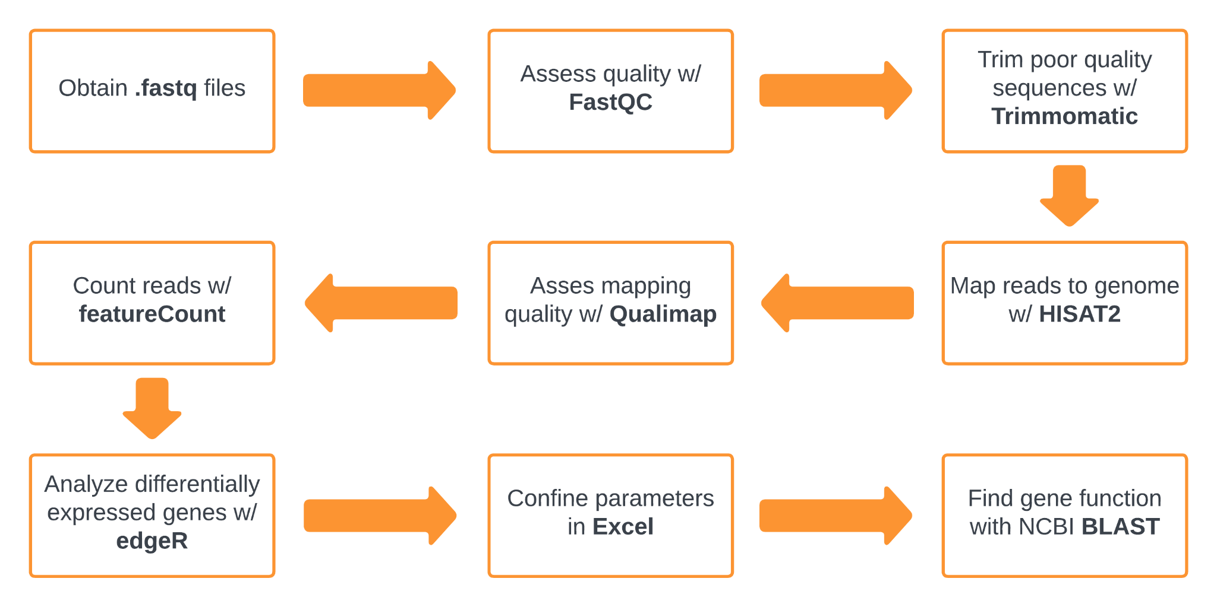
Data Analysis Pathway:

Slide 6
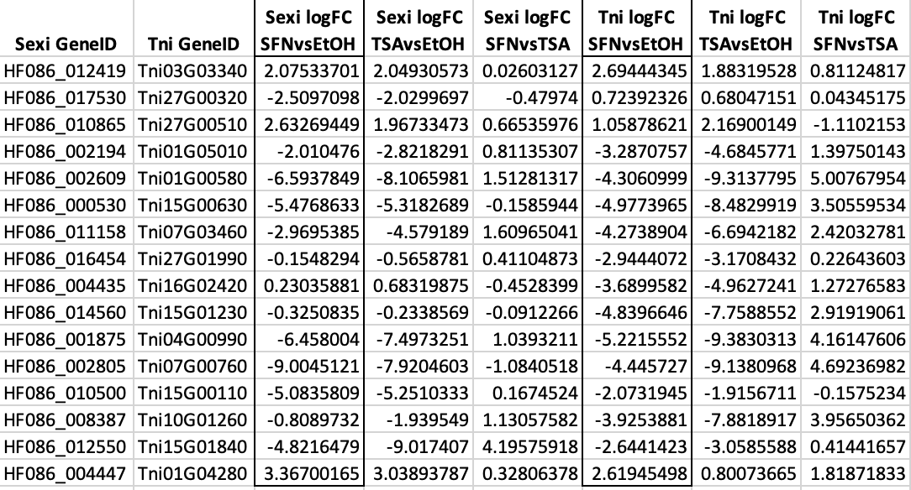
Normalized Data:

Slide 7
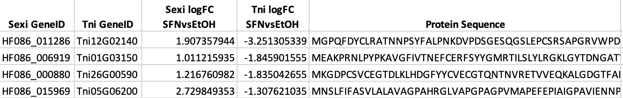
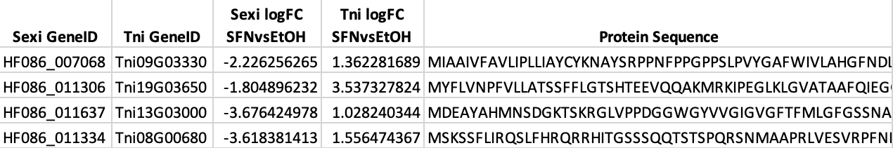
Transformed Data:
If column 3 > 1 and column 4 < -1: Induced in S. exi but Repressed in T. ni
If column 3 > -1 and column 4 < 1: Repressed in S. exi but Induced in T. ni

Slide 8
Conclusions:
S. exi induced/T. ni repressed:
Membrane transporters
Protein vs. protein interaction
Unknown gene function
S. exi repressed/T. ni induced:
Adenosine phosphates (ATP, ADP) – aka Energy
Membrane transporters
Cell cycle control + cell division

Slide 9
Implications for Stakeholders?
National Science Foundation (NSF)
Ecology sector
Agricultural sector
Biotechnology companies

Slide 10
Ethical, legal, societal implications?
Policy makers and regulators
Intellectual property
Bioethics

